Slide 1

Novas’ TOPPLE Programme:
Peer Overdose Prevention
in McGarry House

Slide 2
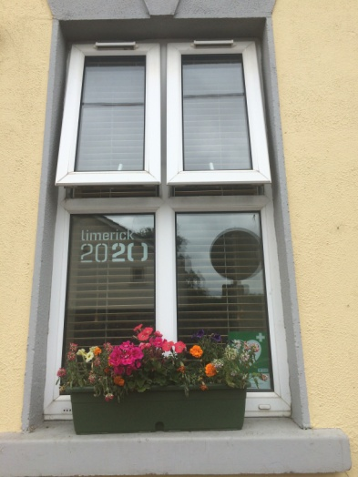
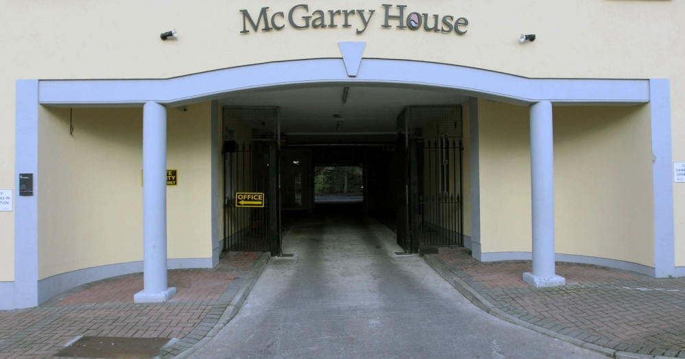
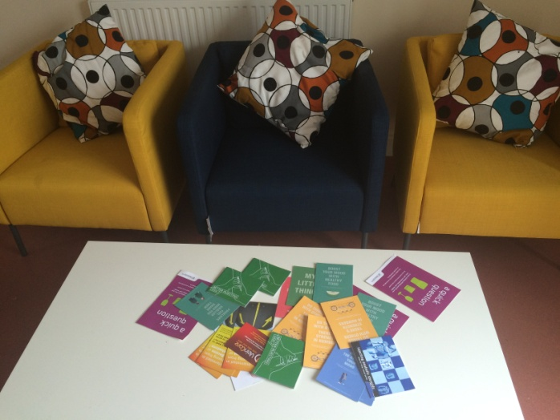
Novas McGarry House
A low threshold homeless facility for men and women in Limerick City
Operates from a Harm Reduction Model
Novas: Housing, Health, Recovery

Slide 3
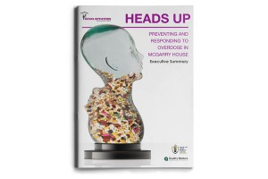
Background to TOPPLE
From May 2012 to November 2013, 34 overdoses occurred onsite.
Novas tendered for research to be carried out in-house.
Quality Matters conducted this research in 2014.
The resulting report, Heads Up: Preventing and Responding to Overdose in McGarry House, won an Irish Healthcare Award in the Best Patient Lifestyle Education project category.
This report recommended the “development and
evaluation of a peers skills and education programme
on overdose risk, prevention and management.”

Slide 4
Programme Development, Promotion and Implementation
Expert Interagency Steering Group: Representatives from Quality Matters, Mid Western Regional Drug and Alcohol Forum, HSE Mid West Addiction Services, Arbour House Treatment Service, UL and Novas
TOPPLE Staff Team: 2 Managers, 2 Project Workers, Dual Diagnosis Worker
Training: Quality Matters and UL GEMS
Open Day (20 attendees)
Follow Up One-to-One Appointments (18 attendees)

Slide 5
The Programme
5 Sessions, 9 Participants, 5 Graduates
Expands the client’s existing knowledge and skills to equip them for overdose prevention work
Enhances the client’s skill set to support peers who are at risk of overdose
Teaches the practical skills of:
  Scene safety
  Communicating with Ambulance and other emergency services
  Recovery position
  CPR
  Use of Naloxone
Informs clients on what services are provided locally and how to make informal referrals
Aims to instil a sense of identity as a worker who has an important role to reduce overdose
Provides support and supervision to clients in their roles as Overdose Prevention Workers
Recognises the expertise of clients and encourages them to contribute to the programme so that it evolves into a more meaningful and real piece of work
Is evaluated and reviewed with a view to improving the programme and making it available to other internal Novas services and external agencies who work with this vulnerable at risk group

Slide 6
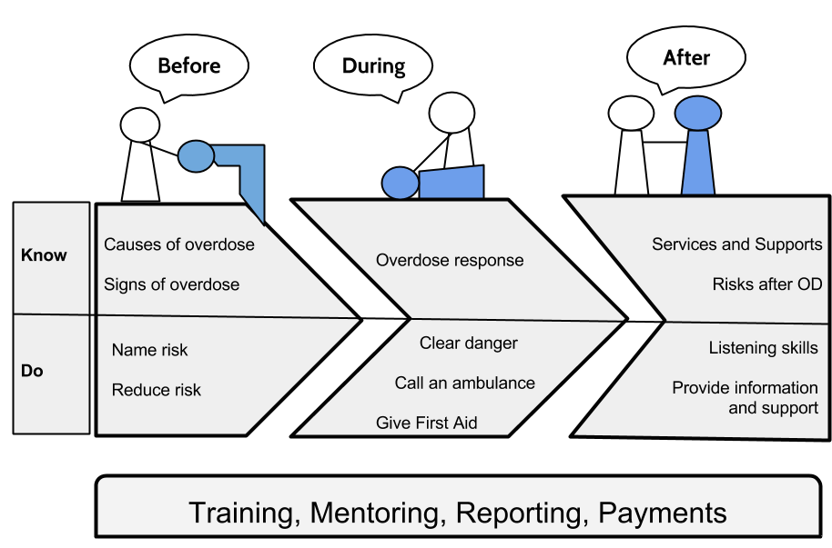
The Sessions
Session 1: Establishing the Group
Session 2: Preventing Overdose
Session 3: Responding to Overdose
Session 4: After an Overdose
Session 5: Practice Review,
Skill Check and Planning
Exam

Slide 7
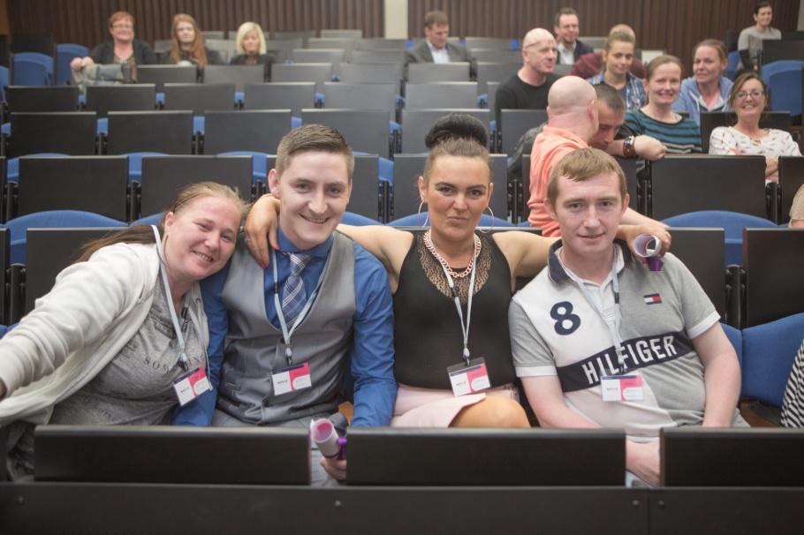
Outcomes
TOPPLE Graduates volunteer as Peer Overdose Prevention Workers for an initial period of 3 months.
At the time of their first group supervision,
the 5 TOPPLE Peer Overdose
Prevention Workers had already:
Provided 28 Prevention Supports
Called an Ambulance Once
Provided 3 First Aid Supports

Slide 8
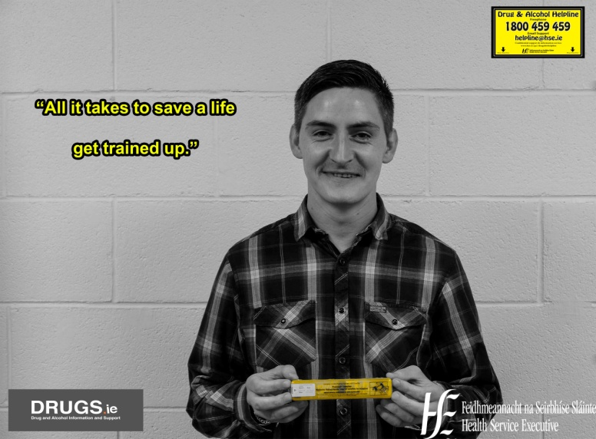
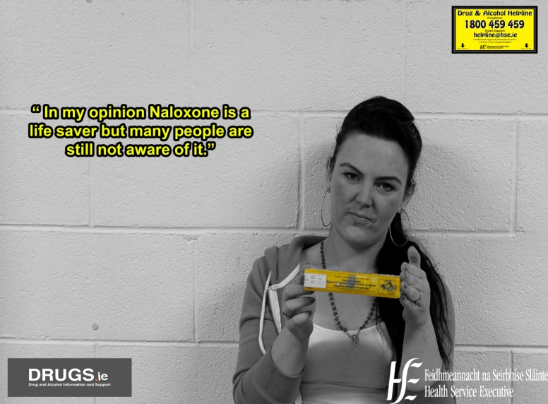
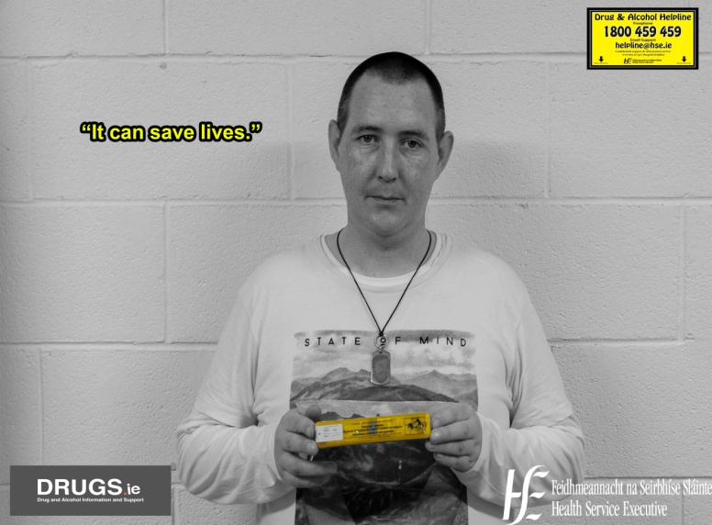
Outcomes (continued)
International Overdose Awareness Day and Overdose Awareness Week events in McGarry House, PALLS and The Ana Liffey Project
HSE Naloxone Programme Posters

Slide 9
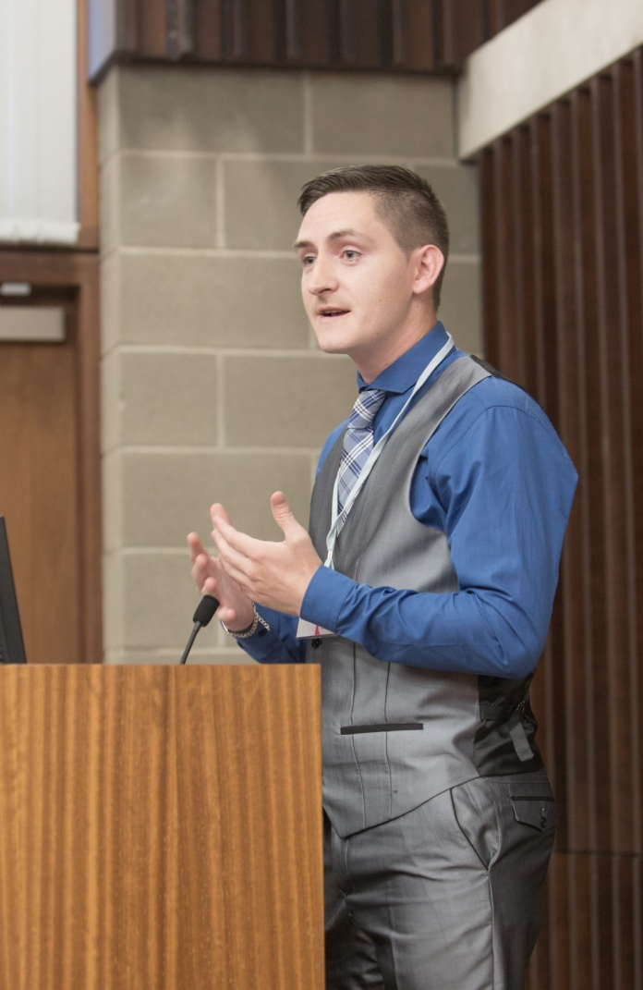
The Future
Evaluation
Further investment in the skills of the
existing Peer Overdose Prevention Workers
(especially in the area of First Aid)
TOPPLE 2 (October)
Making the Programme Guidebook Available
to Other Services

Slide 10
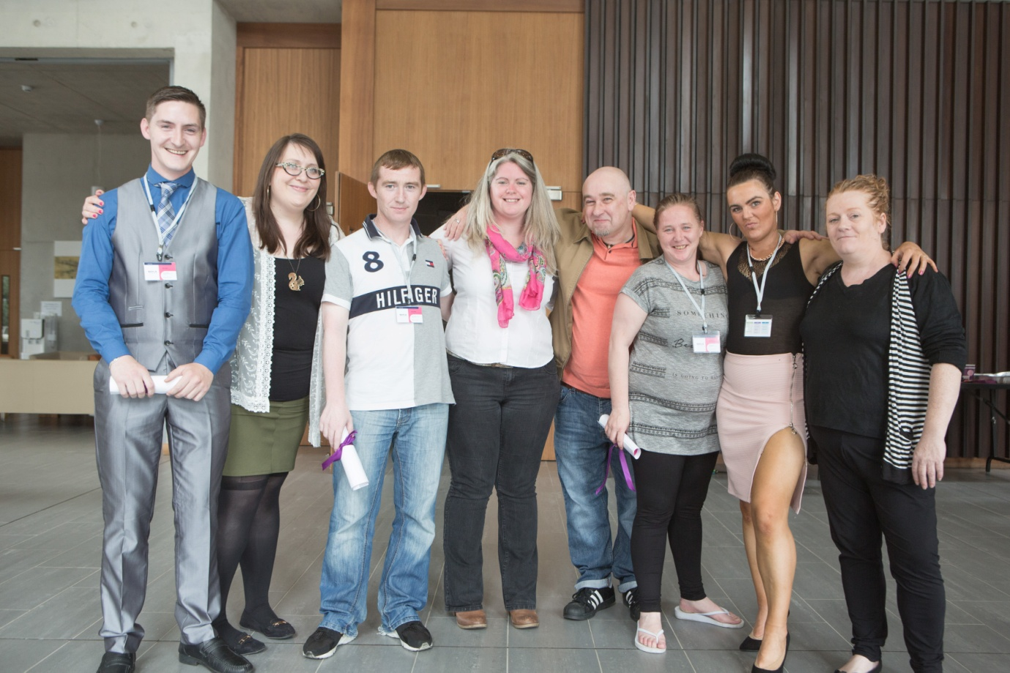
For further information:
Novas Website: www.novas.ie
Email: sinead.carey@novas.ie

Slide 11
Questions?

Slide 12
Thank You

